Slide 1
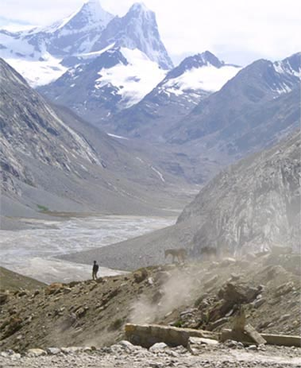
Fellowship of the Heart
Getting Started — the Four Connects, walked around the table on alternating evenings
Evening Series 2026–27 · at the Tittle home · v1.5E DRAFT
All Scripture: ESV · The Companion lesson plans carry the full scripts — these slides carry the room
1
Notes:
DECK TITLE · pre-session · DIVIDER
On screen as the room assembles on night one. All Scripture ESV; the plans carry the scripts; these slides carry the room — and these notes carry you.

Slide 2

SESSION 4
Telling Your Story II
The second running — the teens tell, the round is completed, and the room watches one of its own hold it
Quarter 1: Connect with Self & Others
47
Notes:
S4 · pre-session · DIVIDER
On screen through dinner and as the circle forms. Greet at the door — the slide holds the room.

Slide 3

Session 4 — Tonight’s Road
1 Welcome and centering
2 Joint Footprints check-in
3 Psalm 139 — being known, again
4 Bridge to the split
5 Stories in pairs
6 Merge and one-word landing
7 Homework commissioning — handout + check-in partners
8 The Leader Feedback Round — both leaders
9 Closing container
48
Notes:
S4 · 7:00–8:30 · LEAD: BOTH LEADERS
BEATS:
1. The teens tell today — same question, same pairs, nothing new taught; the completion is the point.
2. A Companion-in-Formation (senior teen) leads the open, the bridge, their own pair, and the close — protocol card in hand, adult across the circle.
3. Same Section 6 preparation as Week 3: re-read within 48 hours; crisis card in pocket; backup on call.
GUARD: The bright line governs everything — the senior leads process; the adult holds care. If the FC1 gate has not cleared, adults lead exactly as Week 3.
CUES: If you are covering: the senior still leads their blocks — receive their leadership as the room does; do not hover, do not re-lead.

Slide 4
Opening Container — the Eight Steps
1 Welcome — five minutes to open the container
2 Phones silenced and put away
3 Stand in a circle
4 One-word check-in — how you actually are, right now
5 Put out / bring in — set something down; bring a blessing in
6 Spoken commitment: “I am here. I am paying attention. I am willing to be moved.”
7 Opening prayer — “Holy Spirit, you are welcome here. Speak. We are listening.”
8 Sit. Begin.
49
Notes:
S4 · 7:00–7:08 · LEAD: CONTAINER HOLDER
BEATS:
1. The Companion-in-Formation opens the night: blessing, container, Week 4 frame — the pieces are required, their own words are fine (card H4.1).
2. You sit in the circle as a participant and do not hover.
CUES: The room registers a teen leading within ten seconds. Let it — no introduction, no explanation, no applause. Receive the opening exactly as the room received it from the Lead Companion in Weeks 1–3.

Slide 5

Joint Footprints Check-In
• “Some of you got to it. Some of you didn’t. Both are fine — ‘we didn’t get to it’ is honest, and honest is what we do here.”
• One sentence about what it was like — “not what was said — that’s yours — just what it was like”
• An arranged parent starts; then it’s open, and optional
• “The work is happening, whether or not we name it tonight.”
50
Notes:
S4 · 7:08–7:25 · LEAD: CONTAINER HOLDER
BEATS:
1. Lead Companion takes this block. 'Some of you got to it, some didn't — both are fine; honest is what we do here.'
2. One sentence on what it was LIKE, not what was said. The arranged parent starts; then open, and optional.
3. Silence after the opener: wait ten seconds, move on — 'The work is happening, whether or not we name it today.'

Slide 6
Psalm 139 — Being Known, Again
• Same psalm as last week, on purpose — nothing new tonight; we’re completing the round
• One idea, repeated: the opposite of being hidden is not being exposed — it is being seen and being safe at the same time
• The parents practiced that last Wednesday. Tonight the teens do
• Put the comparison down — “Every story is its own. … The story you tell tonight is not in competition with any story told in this building last week. Tell yours.”
PSALM 139:23–24
“Search me, O God, and know my heart! Try me and know my thoughts! And see if there be any grievous way in me, and lead me in the way everlasting!”
51
Notes:
S4 · 7:25–7:31 · LEAD: CONTENT PRESENTER
BEATS:
1. Re-read Psalm 139:23–24 only. Nothing new taught — repetition is how it becomes ours: seen and safe at the same time.
2. Say the comparison word out loud: put down measuring your story against your mom's or dad's. Every story is its own; the parents went first so you would never have to guess, not so you would have a bar to clear.
3. If Week 3 flagged fixing: one gentle sentence — 'listening to receive is its own discipline.'

Slide 7
Bridge to the Split
1 “It’s one question — tell the story of how you got here, and what has shaped you.” The depth is yours to choose
2 “When you’re listening — don’t fix, don’t advise, don’t relate back. Receive, and after each story, bless.”
3 “Nothing leaves your pair. Not a phrase, not a name, not a story.”
• Same pairs and same rooms as last week — your family stays with you
52
Notes:
S4 · 7:31–7:32 · LEAD: CONTENT PRESENTER · TRANSITION
BEATS:
1. The senior takes the bridge from the card: one question; listeners receive and bless — no fixing, no advising, no relating back; nothing leaves the pair.
2. The senior prays, then sends: same pairs, same rooms as last week, families together; back at 5:12.
CUES: Ten or fewer — 'We're staying right here, one circle, same rules,' and flow straight into the telling.

Slide 8
Stories in pairs — the Teens Tell
• The teens tell — same pairs, same single question, same blessing. Second running
1 Story — 5–7 minutes. Nobody interrupts, even the silences
2 Silence — ten seconds
3 Blessing round — the arranged parent blesses first, then the circle: one or two sentences each
• Parents tonight: receive and bless — no correcting the record, no filling silences
• “What’s said in this circle stays in this circle. And when someone is telling, we’re looking at them. We’re receiving.”
53
Notes:
S4 · 7:32–8:16 · LEAD: CONTENT PRESENTER · PAIRS
BEATS:
1. The teens tell — 5–7 minutes each, ten seconds of silence, then blessing; the arranged parent speaks the first blessing after every story.
2. In the senior's pair: the senior tells FIRST (the adult steers their blessing round), then facilitates the rest, card in hand; the adult sits directly across, silent through mechanics, holding care.
3. Parents receive without correcting the record, filling silences, or bracing — the teen's telling stands today.
4. Out of time: compress blessings to one sentence each; every teen gets told.
GUARD: The handoff rule never bends — anything heavy, the senior says '[Adult's name], I'd like you to take this' and holds the container in silence; the adult takes it instantly and completely, then hands the process back. The senior never counts as one of the two adults; the adult runs any Settle Protocol.

Slide 9
Merge and One-Word Landing
• What happened in your pair stays in your pair
• One word, when you’re ready, about what tonight was like — an arranged parent starts. You can pass
• “The round is complete — every person in this room, parent and teen, has now told a piece of their story to a circle that blessed them for it.”
• “Rooms like this one are rare. They’re also the kind of room God shows up in.”
54
Notes:
S4 · 8:16–8:20 · LEAD: CONTENT PRESENTER
BEATS:
1. Lead Companion takes the merge. Let the room settle; do not break the texture with energy.
2. One word each; the arranged parent starts; pass allowed. Receive — eye contact, small nod, no comment.
3. Name the completion: every person in the room, parent and teen, has now told and been blessed. 'Rooms like this are rare. They're the kind of room God shows up in.'

Slide 10

Homework — Two Weeks, Four Parts
• Joint Footprints — for every family that hasn’t done it yet. Parent and teen, twenty minutes, sometime this week
• Not in the car, not in front of a screen. Phones away
• Five minutes telling, a follow-up question or two, and one sentence: “What I love about your footprints is...” Then swap
• “Families who already did it — you’re done; don’t force a repeat.”
• Everyone keeps the morning question and the evening journal note going — five minutes in the morning, two at night
55
Notes:
S4 · 8:20–8:24 · LEAD: CONTENT PRESENTER
BEATS:
1. Parent Co-Companion leads. Joint Footprints (H3.5) for every family that has not yet done it — twenty minutes, not the car, not a screen.
2. Families who already did it are done — do not force a repeat.
3. Everyone keeps the morning question and evening note going: 'that rhythm is quietly doing more than any single evenings.'

Slide 11
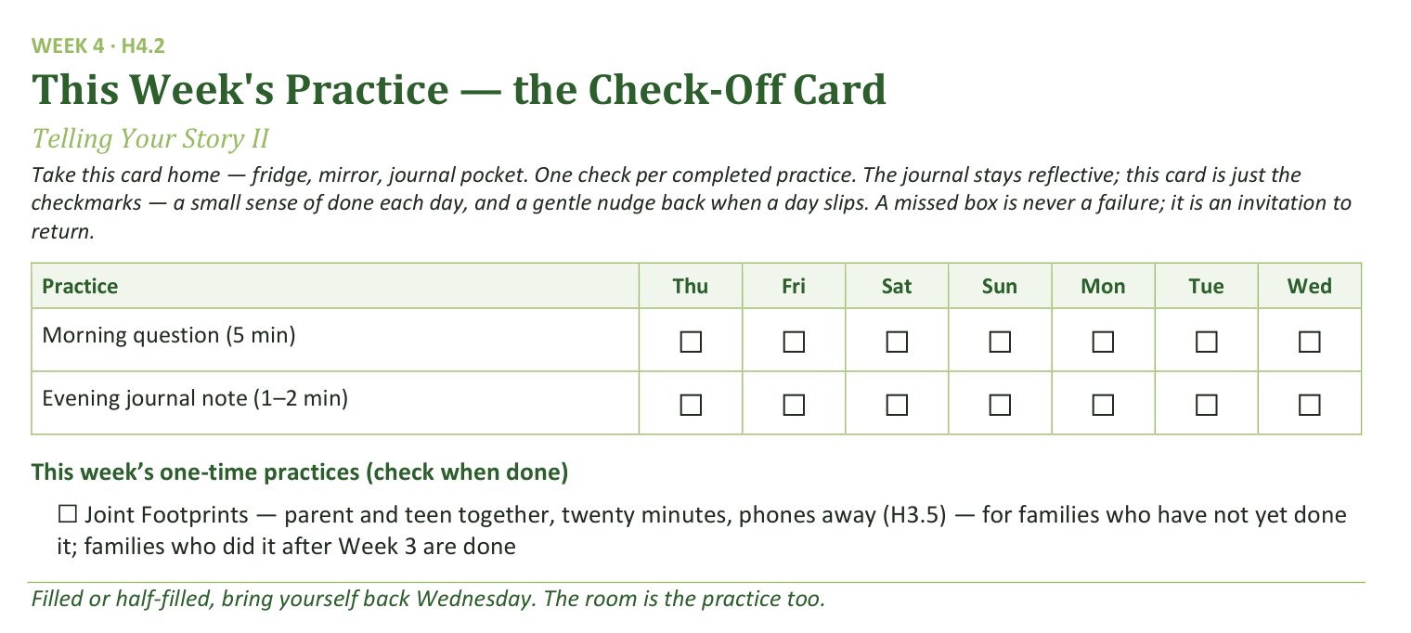
Your Take-Home Card — This Session’s Practice
Handed out now — fridge, mirror, journal pocket.
56
Notes:
S4 · 8:20–8:24 · LEAD: CONTENT PRESENTER
BEATS:
1. Check-off card (H4.2): daily morning question and evening note; the Joint Footprints box is only for families not yet done.
CUES: Rides inside the practice block.

Slide 12
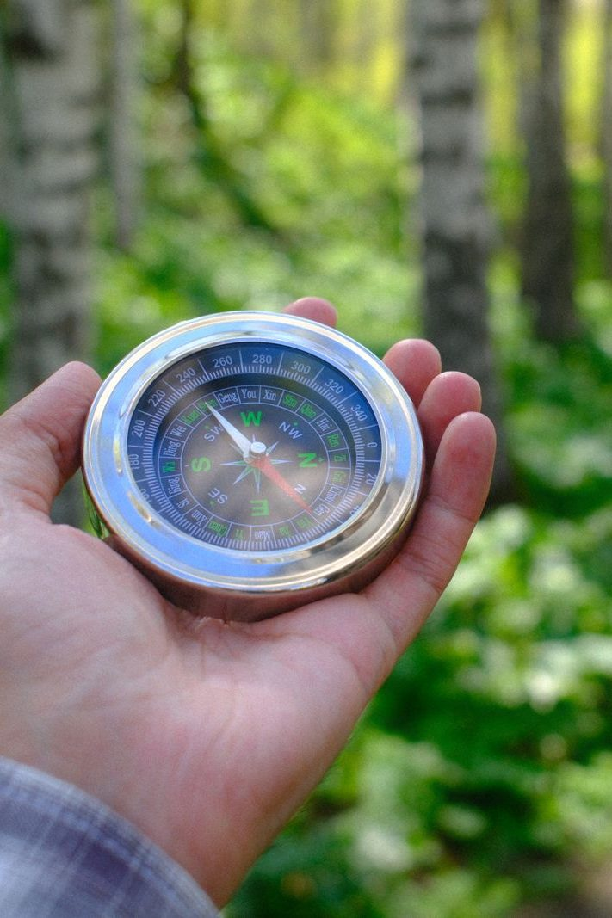
The Leader Feedback Round
• Two rounds, same as every session — the container holder first, then the content presenter: three things each
– “What I think went well tonight: ______”
– “What I’d do differently next time: ______”
– “If I were to teach tonight’s process to someone, I would tell them: ______”
• Then the room — the same two questions about tonight
• The leaders receive without defending — “thank you” is the whole response
57
Notes:
S4 · 8:24–8:28 · LEAD: BOTH LEADERS
BEATS:
1. You frame it; the senior answers the three things FIRST, you answer the first two second; the room's feedback covers both.
2. Keep the room's words specific and for-you-shaped: 'the way you waited out the silence' is gold; 'you did great' is not.
3. Both leaders receive without defending — 'thank you.'
CUES: The team's one growth item was agreed in a ten-second sidebar during the merge — never improvised in front of the room; affirmations outweigh it in number and specificity. Think hard before dropping this round on a night a senior led — it is part of their formation.

Slide 13
Closing the Container + Aaronic Blessing
• We close the way we opened — the container, six steps:
1 Stand again — same circle, same posture as the open
2 One-word landing — compare it to your opening word
3 The one thing you are taking from tonight
4 The one practice — committed aloud, or modified to one you will actually keep
5 Blessings — specific, witnessed, short
6 Closing prayer — and the Aaronic blessing, spoken over each other, face to face
THE AARONIC BLESSING — NUMBERS 6:24–26
“The Lord bless you and keep you;
the Lord make his face to shine upon you, and be gracious to you;
the Lord lift up his countenance upon you, and give you peace.”
58
Notes:
S4 · 8:28–8:30 · LEAD: CONTAINER HOLDER
BEATS:
1. The senior closes from the card: your story goes home with you, nobody else's; help named; Aaronic blessing; 'Go gently this week.'
2. Adults stay accessible ten minutes after, as always.
CUES: Find the senior privately before they leave: one sentence of thanks, one question — 'How are you, after that?' — and a listen. No coaching today; that waits for the debrief and the Lab.

